Slide 1
L T M : Local Travel Mate
20152775 Abdullaev Farkhodjon
20152776 Erkinov Habibilloh
20131658 김남우

Slide 2
00
Description of project
We are planning to make an application that serves for the tourists who are making a travel for the first time to South Korea and do not have any touristic information about the country. Most tourists want to meet local friends during their traveling and know how the locals enjoy their time and culture in their daily life. Locals also wanna meet foreigners. Tourists who use our application will have the opportunity to have a personal guide who know well about touristic places or we also planning to implement some tourism infos and tour plans to our application which can be very helpful for them who do not need any guide. We will be providing service for both guides and tourists, by using our application if someone who have knowledge about touristic places can register to our application and serves to the customers.

Slide 3
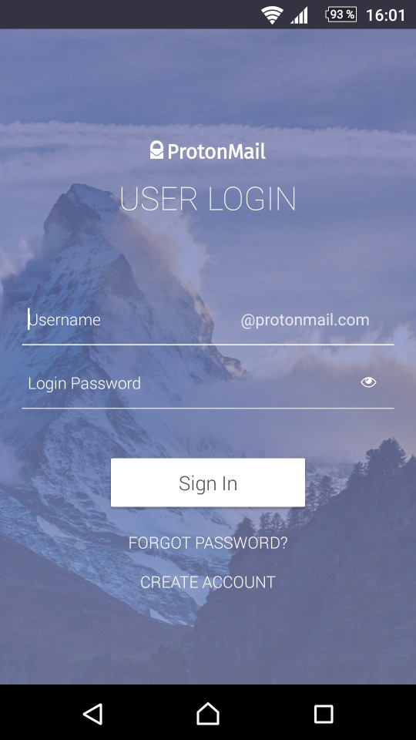
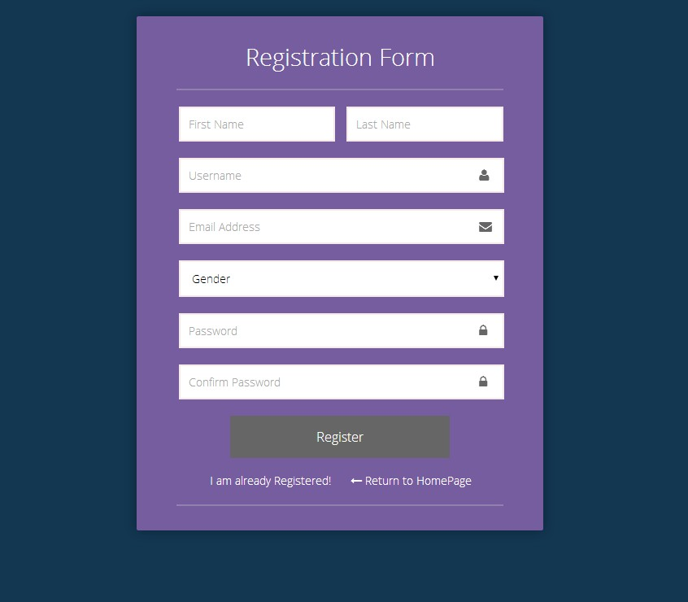
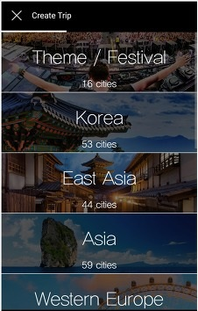
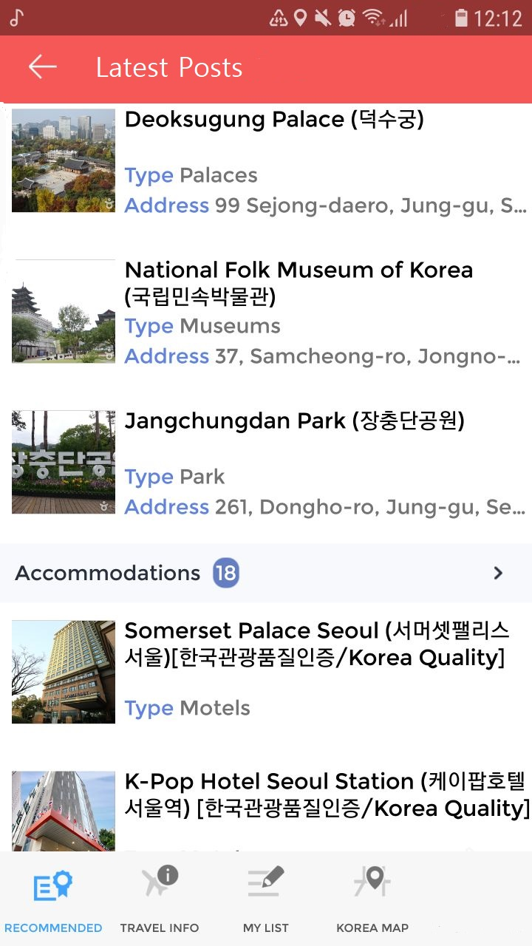
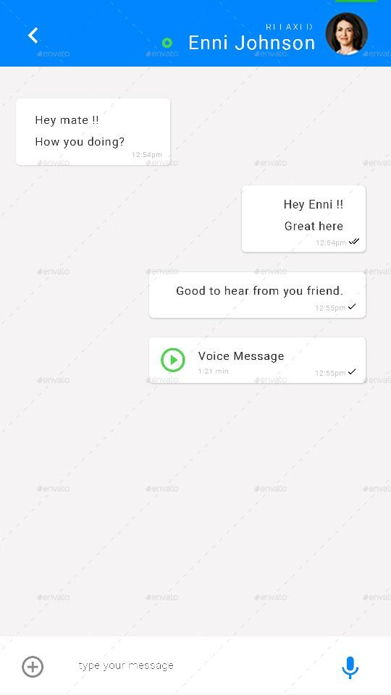
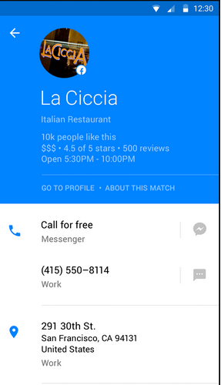
Activity Flow

Slide 4

01
Main Page
Mock-up Screenshot
Use case Diagram
Use case Scenario

Slide 5
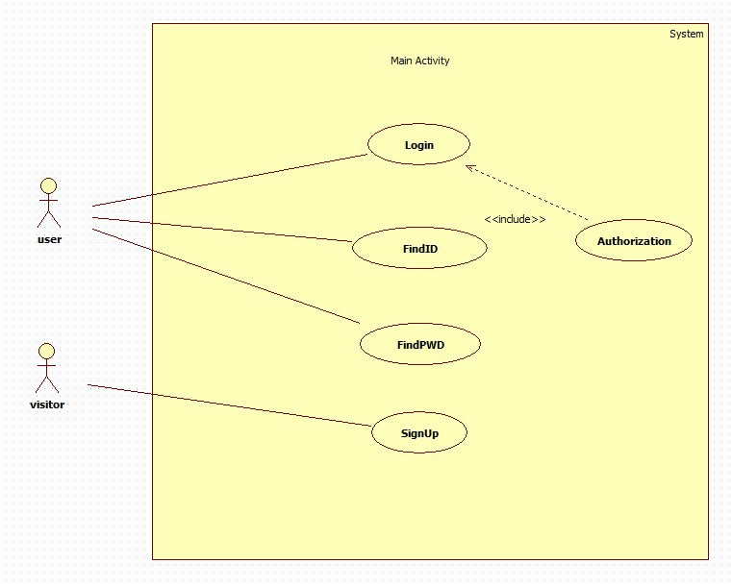
01
Use case Diagram

Slide 6
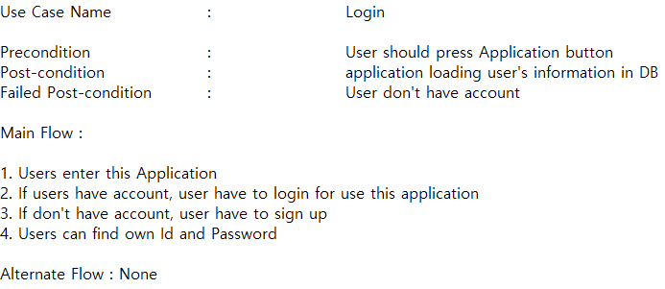
01
Use case Diagram

Slide 7
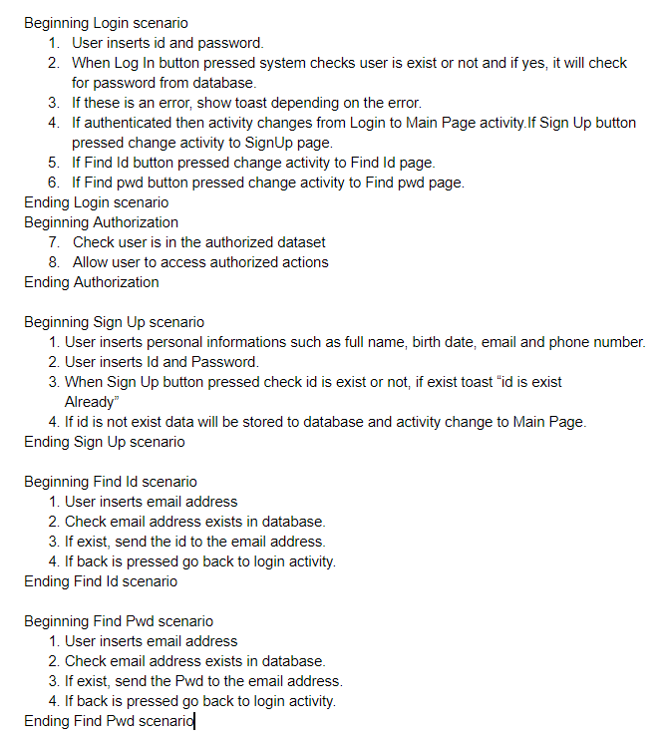
01
Use case Scenario

Slide 8
02
Select Country
Mock-up Screenshot
Use case Diagram
Use case Scenario

Slide 9
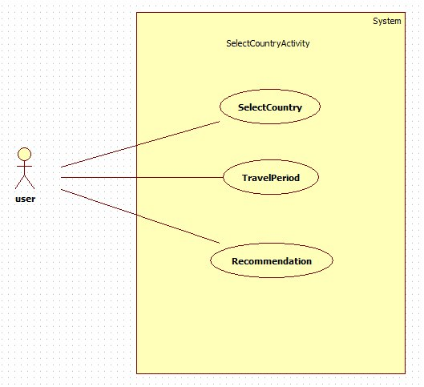
02
Use case Diagram

Slide 10
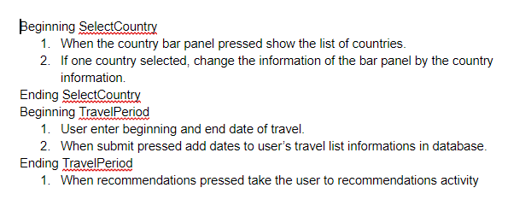
02
Use case Scenario

Slide 11
03
Board Page
Mock-up Screenshot
Use case Diagram
Use case Scenario

Slide 12
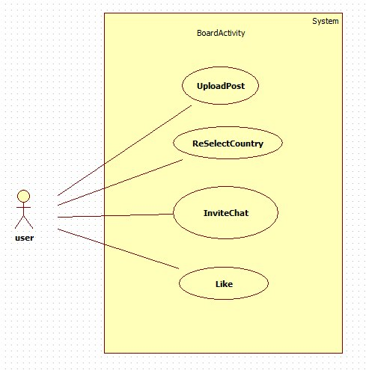
03
Use case Diagram

Slide 13
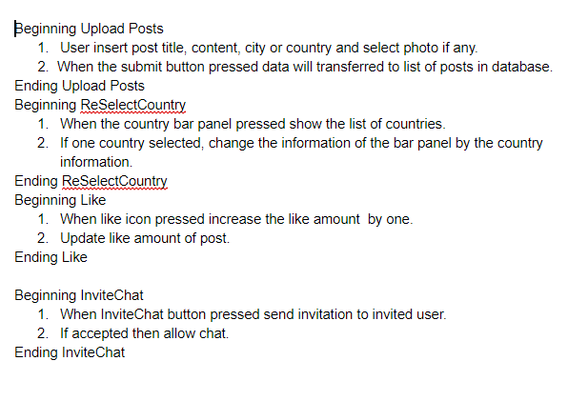
03
Use case Scenario

Slide 14
04
Chat Page
Mock-up Screenshot
Use case Diagram
Use case Scenario

Slide 15
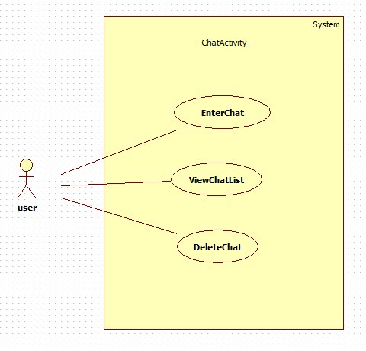
04
Use case Diagram

Slide 16
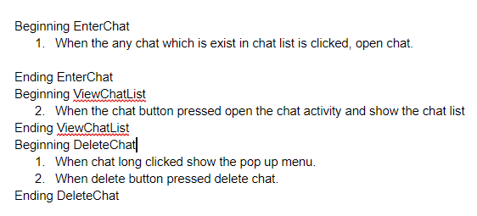
04
Use case Scenario

Slide 17
04
Chat Page
Mock-up Screenshot
Use case Diagram
Use case Scenario

Slide 18
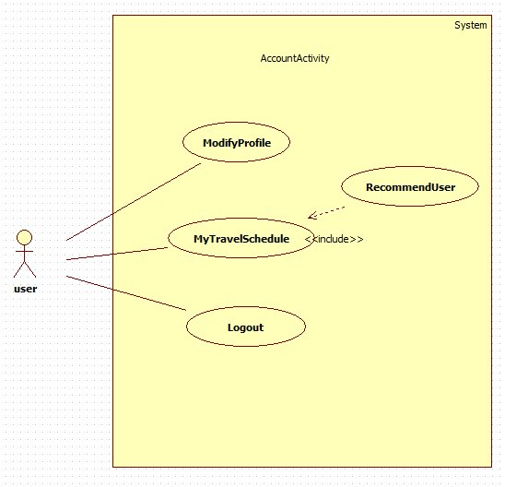
04
Use case Diagram

Slide 19
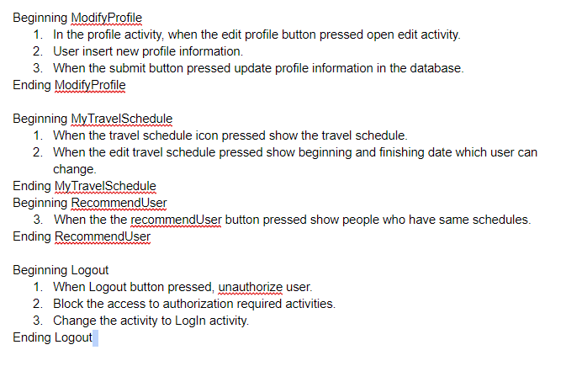
04
Use case Scenario

Slide 20
THANK YOU

